Slide 1

SRE Program Project --------- Log Analysis

Slide 2
Problems
Toil for engineers during incidents/analysis.
High MTTR (nearly 30 mins)
Many clusters
Many servers in each cluster
Many different types of logs
Many types of log format
Lack of consolidation of all this information in a single place to get intelligence.

Slide 3
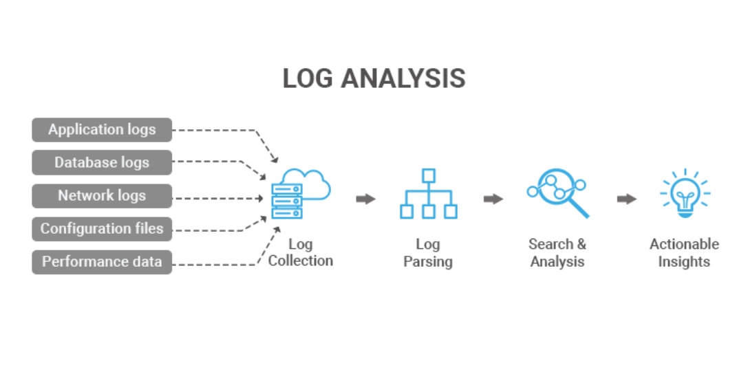
Solution

Slide 4
Technologies
Django
Python3.8
Ansible
MySQL

Slide 5
Demo

Slide 6
Scenarios
Troubleshooting incidents
Application performance management
Exception analysis
Configuration changes
Health checks
To get statistics for actionable intelligence

Slide 7
Features
Get and parse application logs from different servers.
Categorise / Filter based on severity, server, date, subsystem.
Search the messages in the logs
UI-interface.
Single-sign on to access this tool
Integrate with the SRE platform

Slide 8
Improvements
Log parsing for different formats
Automated Log parsing
AI models on parsed log data
Maintain data for 30 days and later maintain only the aggregated data
This can be used as a opportunity to bring about standardization in log formats across the all apps.

Slide 9

Lets reduce the MTTR and resolve the issue ☺

